Slide 1
Credit Karma
Enterprise Architecture Implementation
Dylan Sager & John Gentry
Northwestern University

Slide 2

Our Approach to Digital Transformation Success
One Team
John Gentry: Experience in developing enterprise eCommerce analytic solutions, specifically focused on customer analytics.
Dylan Sager: Experienced Data Scientist with experience across industries. Specialized in Digital Transformations and Analytics at Scale
One Plan
12-Month Digital Transformation Roadmap
Lighthouse Projects - Focus on Data Architecture
Key Considerations for Solution Architecture
Develop Solution based on Lighthouse framework
Governance - Controls in place
Measuring Success of Initiatives

Slide 3

Industry Trends
Rapid Growth, especially in new companies. New investments in Fintech have risen to $30.8 billion from $1.8 billion in 2011. (Galvin, et al., 2018)
A Great user experience is no longer enough. Companies must figure out a way to differentiate themselves.
Infrastructure is changing. Digital innovation is often hindered by legacy IT, an update is needed to remain competitive. (Galvin, et al., 2018)
Acquisition by Intuit in 1Q2020 creates enormous opportunity

Slide 4
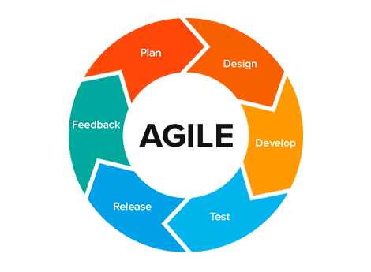
12-Month Digital Transformation Roadmap
Advancing Data Science at Credit Karma
Scoping & Value Study
1) Work alongside business partners to better understand current system architecture and tech stack. 2) Identify specific use cases within the business for high priority initiatives.
3) Receive full funding commitment and buy-in from senior management.
Ramp-Up & Execution
1) Assess resources and timeline for high-priority initiatives to determine if the team can take on additional projects.
2) Assess operating model and prepare to expand the teams capabilities by adding technical developer resources. New operating model may be needed if team is not able to execute low-risk projects.
3) Ensure that the data architecture for low-risk projects is modular enough to support the more advanced framework of high-risk projects.
2020 Q3
2021 Q1
2020 Q2
2020 Q4
Planning & Target Setting
1) Begin defining goals for the following low-risk high-reward initiatives:
Customer Segmentation
Portfolio Management
Customer Support
Recommendation Engines
2) Build capable team with data scientists that have experience using the Apache framework to build high performing data systems.
3) Adopt Agile approach to project management
Capability Assessment
1) As low-risk projects mature and resources move on to higher risk projects, assess capability of each new feature.
2) Monitor new systems for performance.
3) Plan for more complex projects that have higher value to the company.

Slide 5
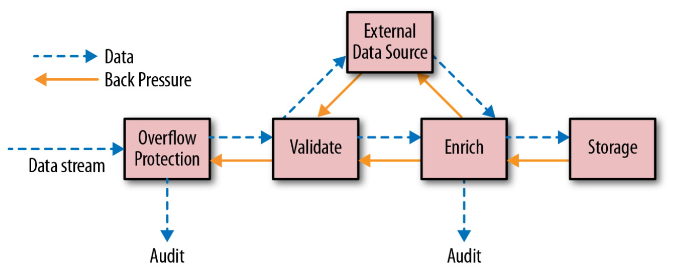
Solution Architecture
Important Considerations for Data Pipeline
Need lightning fast data pipeline: 100+ Million Active Users on Android/Apple Mobile
High throughput: Fast compute speed of data
Fast data transformations
Scalability across distributed environments
Easily add/remove user nodes without interference
High volume: Many transactions per minute
Immediate Analytical Insights: Provide users with immediate financial insights
Figure 1. Illustrates the flow control of data and backpressure in a data stream.
Figure 1: https://www.oreilly.com/ideas/transforming-enterprise-integration-with-reactive-streams

Slide 6

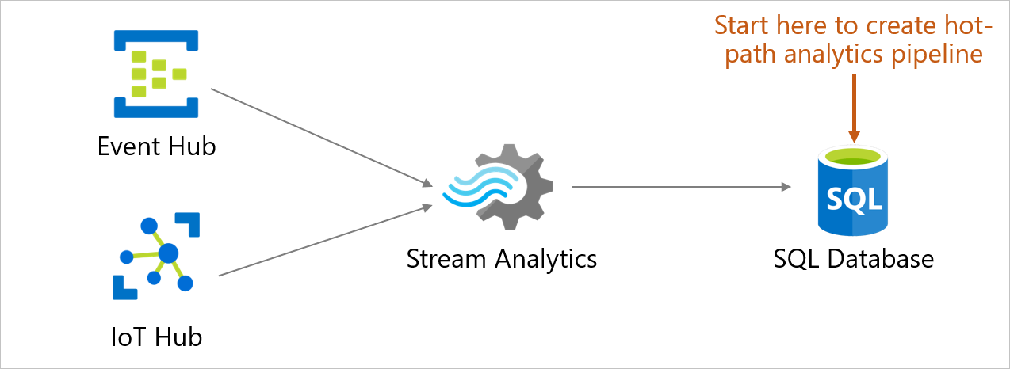






Proposed Architecture
Azure Cloud Computing Tech Stack
Data Storage - Hybrid Cloud Environment
Legacy databases duplicated into an Azure Data Lake Gen 2 Container
Sensitive data kept on-prem using MongoDB
Streaming Data
Azure Event and IoT hubs monitor events to trigger data capture
Azure Stream Analytics used to quickly monitor high velocity data pipelines
Processed Streaming Data is stored structured in Azure SQL
Machine Learning Development
Azure Databricks is used to perform ETL and create data models
Deployment
Analytics applications are deployed and monitored using Azure Machine Learning
Source: azure.microsoft.com

Slide 7
Initial Light-House Projects
Develop Operating Rhythm with Low-Med Risk, Med-High Reward Projects
Phase 1
Customer Segmentation
Customer attribute data model that powers the segmentation engine will help provide framework for other attributes to be more successful. Ability to segment customer base and test new features on targeted groups lowers risk.
Portfolio Management
Need to deliver higher value service to compete with more established Fintech companies.
Phase 2
Customer Support
Customers expect to quality customer service when dealing with personal banking finances. Service levels must be better then what customer gets at a typical bank.
Recommendation Engines
High value to customers. Creating relevant and accurate investment recommendations for customers is highest potential value generator.

Slide 8
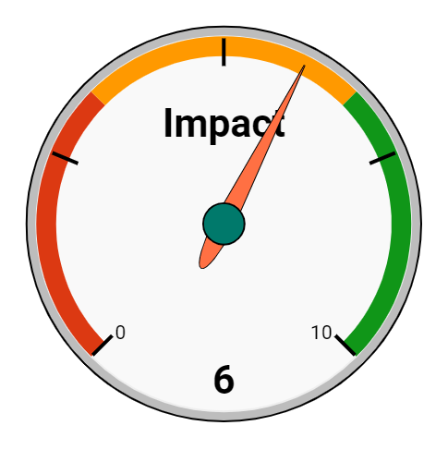
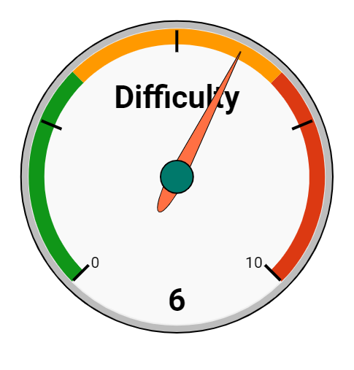
Customer Segmentation
Derive insights based on similar customer groupings
Internal departments can use customer groupings to derive new insights such as:
Customer habits
Customer needs
Targeted advertisements
Medium-high impact, depending on department. This project provides opportunity to scale in the future
The downside of this project is that it is relatively difficult to implement
Obtaining and transforming siloed data may prove challenging
Estimated time to complete: 5-6 months
*Higher is better
*Lower is better
Estimated Cost: $500k

Slide 9
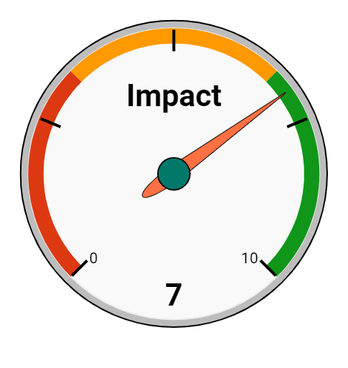
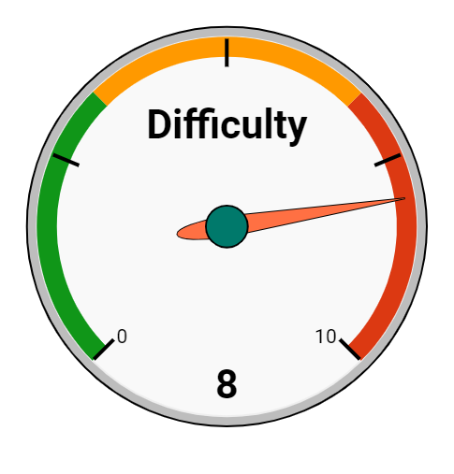
Portfolio Management
Delivering multiple financial solutions in a single, integrated page
A complete solution allows a customer to view all accounts and investments in a unified area
Credit Karma can use this information to detect customer behavior and develop new products the customer may be interested in
Difficult to implement. Requires sign-off and integration from many other financial partners.
Would require heightened data governance and security measures to assure partner financial data is not exposed
Estimated time to complete: 8-10 months
Estimated Cost: $750k

Slide 10
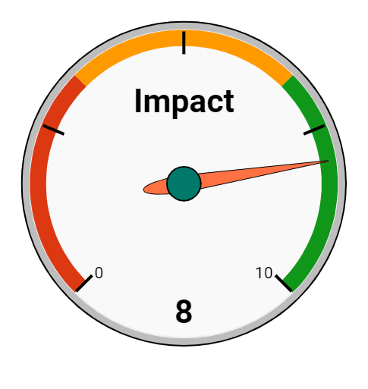
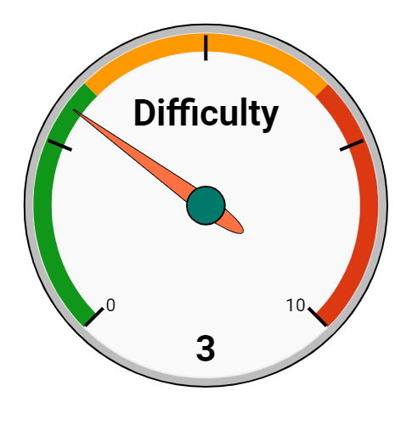
Customer Support
Provide top-of-the-line customer service while reducing labor costs
It is estimated that 70% of customer service requests can be completed by automated bots (VentureBeat, 2018)
Credit Karma can save money in labor costs by implementing this method, allowing this money to be used on further transformational ventures
Fairly easy to implement within existing process
High impact to many areas of business - Additional funding and hiring can shift from call centers to innovation
Estimated time to complete: 3 months
Estimated Cost: $200k

Slide 11
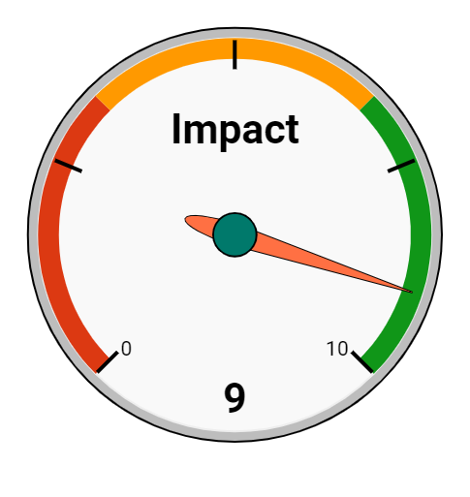
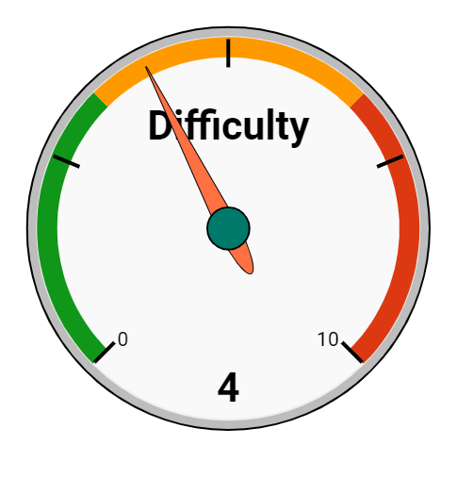
Recommendation Engines
Match users to partner products
Recommendation engines provide Credit Karma the opportunity to increase customer satisfaction, while also benefiting from increased profit
We would suggest partnering with other financial institutions that offer different financial solutions. Each successful referral should net a payment from a partner.
Doing this at a large scale will create a revenue stream, while also increasing customer satisfaction
Estimated time to complete: 4 months
Estimated Cost: $350k

Slide 12
References
Bonér, J., & Klang, V. (2018, March 7). Transforming enterprise integration with reactive streams. Retrieved from https://www.oreilly.com/ideas/transforming-enterprise-integration-with-reactive-streams
Galvin, J., Han, F., Hynes, S., Qu, J., Rajgopal, K., & Shek, A. (2018, December 1). Synergy and disruption: Ten trends shaping fintech. Retrieved from https://www.mckinsey.com/industries/financial-services/our-insights/synergy-and-disruption-ten-trends-shaping-fintech
VentureBeat. (2018, November 30). Bots and AI are shrinking call centers and boosting profits (VB Live). Retrieved from https://venturebeat.com/2018/11/26/bots-and-ai-are-shrinking-call-centers-and-boosting-profits-vb-live/

